Slide 1
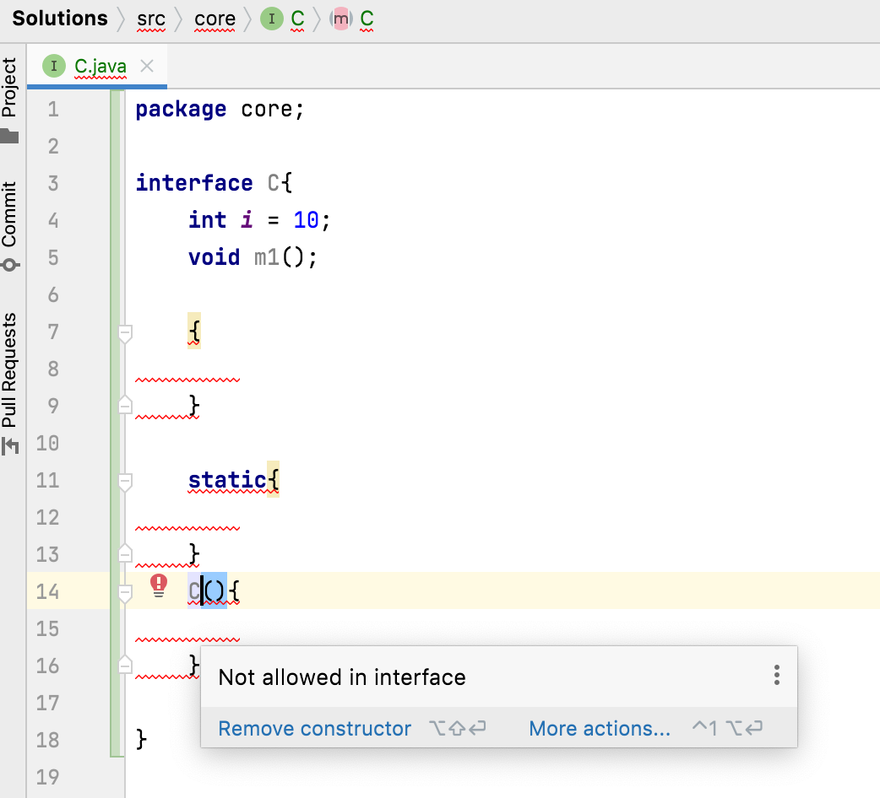

Can interfaces have constructors, static initializers and instance initializers?
No
Interfaces can’t have
Constructors
static initializers
instance initializers.
Interfaces Have only
Methods
Fields

